Slide 1
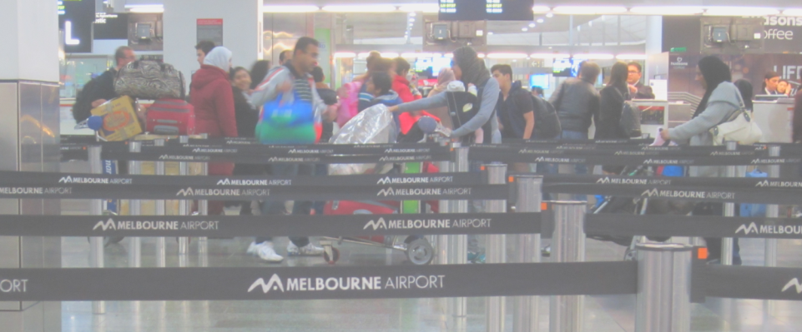
World’s busiest airports and their public transport links
Daniel Bowen - @danielbowen
Public Transport Users Association - @ptua

Slide 2
World’s busiest airports
Rank | Airport | Country | Passengers per annum (2011) | Rail link?
1 | Atlanta | USA | 92,365,860 | Yes
2 | Beijing | China | 77,403,668 | Yes
3 | London Heathrow | UK | 69,433,565 | Yes
4 | O’Hare, Chicago | USA | 66,561,023 | Yes
5 | Haneda, Tokyo | Japan | 62,263,025 | Yes
 | …
31 | Sydney | Australia | 36,022,614 | Yes
50 | Melbourne | Australia | 28,060,111 | No
69 | Brisbane | Australia | 20,589,207 | Yes
Melbourne 2014-15: more than 32 million
Notes:
2011 figures: http://www.guardian.co.uk/news/datablog/2012/may/04/world-top-100-airports#data
Melbourne 2014-15 figures: http://melbourneairport.com.au/about-melbourne-airport/media/media-releases/melbourne-airports-2014-15-passenger-traffic-results-1748.html
Melbourne Airport also has about 12,500 workers. Airports are a significant trip generator in many urban areas.

Slide 3
World’s busiest airports
5 in the USA,
plus Melbourne
Notes:
Shuttle means a short distance dedicated shuttle connection to a rail link
Shuttles are usually bus, but Paris Charles De Gaulle has a RAIL shuttle to the RER station.
Top 50: 39 have links (4 with shuttles), 5 under construction, 6 don’t – Melbourne plus 5 cities in the USA

Slide 4
Airports without rail (by 2021)
Rank | Airport | Country | Passengers per annum
20 | Las Vegas | USA | 41,479,572
24 | Houston | USA | 40,170,844
25 | Charlotte | USA | 39,043,708
32 | Orlando | USA | 35,356,991
42 | Detroit | USA | 32,419,181
50 | Melbourne | Australia | 28,060,111
55 | Antalya | Turkey | 25,183,142
58 | La Guardia, NYC | USA | 24,028,400
61 | Palma, Majorca | Spain | 22,723,837
72 | Bogota | Columbia | 20,327,901
80 | Dublin | Ireland | 18,735,944
 | (and 6 others)
Notes:
All in the top 50 are in car-dominated American cities, plus Melbourne.
Journey to PT work mode share (metropolitan area except Charlotte):
Las Vegas 3.18%
Houston 2.24%
Charlotte 3.5% (city area only)
Orlando 1.85%
Detroit 1.62%
Melbourne 16.1%
http://www.thetransportpolitic.com/2010/10/13/transit-mode-share-trends-looking-steady-rail-appears-to-encourage-non-automobile-commutes/
https://chartingtransport.files.wordpress.com/2012/10/pt-mode-share-trend7.png

Slide 5
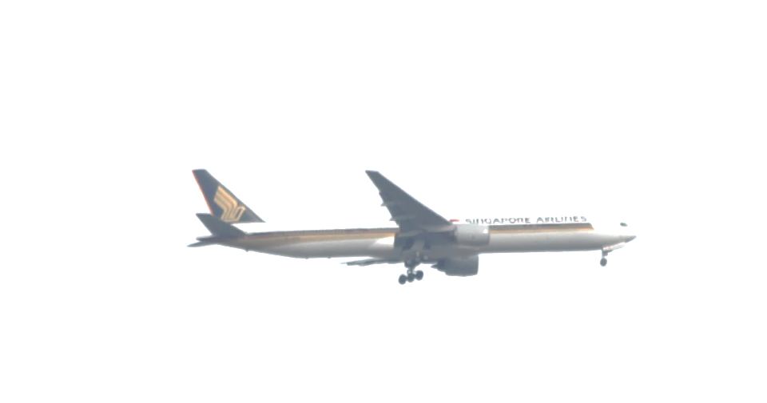
World’s busiest airports
Notes:
Includes shuttle connections
About 2 opening each year.
2015: Helsinki and Toronto
2016: Denver, Jakarta and Taipei

Slide 6
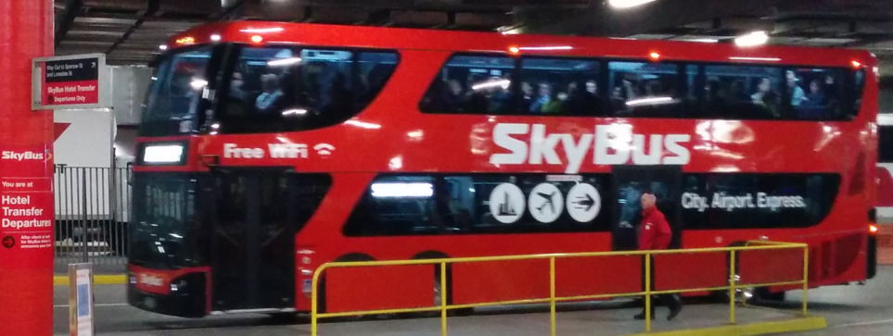
Comparing modes
 | Bus | Tram | Heavy rail
Infrastructure costs | Low | Medium | High
Speed | Slow to medium | Slow to medium | Medium to fast
Capacity | 50-100 | 100-200 | Up to 1000
Notes:
Why rail? It’s not about city envy, it’s about the best mode for the job. Major airports are huge traffic generators.

Slide 7
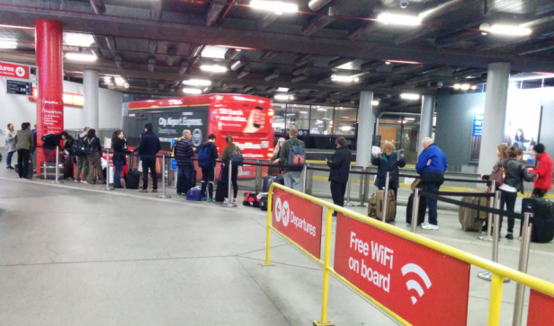
Skybus today
Frequency good – every 10 minutes
Capacity – medium
Crowded – people left behind
Congestion
Cost
Best mode for the job?
Notes:
$18 one way (but high fares are common for airport express PT)
Skybus can be improved. Congestion could be fixed by enforcing existing Citylink “express” lanes and providing bus lanes where needed, though this wouldn’t fix the crowding.
More buses can be put on, but at some point the patronage will go beyond what buses can handle.
And what about providing a service that will attract a higher mode share?

Slide 8
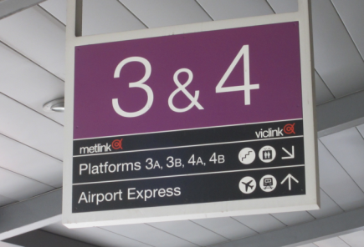
Airport rail for Melbourne – What’s needed?
Needs good frequency, every 10 minutes
Reliable fast travel time, 25 minutes max
Feed directly into rail network
Affordable fares
Good connections
Notes:
Learn lessons from Sydney (expensive), Brisbane (infrequent, expensive)
Need solutions that also cater for airport workers, not just travellers. Good interchange with local services.
Government favours route via Albion. Other proposals include a high speed line, branch from Broadmeadows line, and diversion of Upfield line.

Slide 9
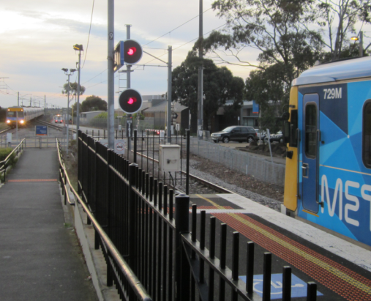
Don’t forget other needed upgrades
Other rail lines: Cranbourne East/Clyde, Doncaster, Monash/Rowville
Duplication: Melton, Altona, Cranbourne, Upfield
Tram, bus priority, extensions
“Every 10 minutes to everywhere”
Single track bottleneck
Notes:
Airport Rail is not the only upgrade our PT network needs.
The government is already starting to move on the Metro rail tunnel, level crossings, Mernda rail, and eventually upgraded signalling. But what else is needed?

